Slide 1
Ethical Student Hackers
XSS Deep Dive

Slide 2
The Legal Bit
The skills taught in these sessions allow identification and exploitation of security vulnerabilities in systems. We strive to give you a place to practice legally, and can point you to other places to practice. These skills should not be used on systems where you do not have explicit permission from the owner of the system. It is VERY easy to end up in breach of relevant laws, and we can accept no responsibility for anything you do with the skills learnt here.
If we have reason to believe that you are utilising these skills against systems where you are not authorised you will be banned from our events, and if necessary the relevant authorities will be alerted.
Remember, if you have any doubts as to if something is legal or authorised, just don't do it until you are able to confirm you are allowed to.
Relevant UK Law: https://www.legislation.gov.uk/ukpga/1990/18/contents

Slide 3
Code of Conduct
Before proceeding past this point you must read and agree to our Code of Conduct - this is a requirement from the University for us to operate as a society.
If you have any doubts or need anything clarified, please ask a member of the committee.
Breaching the Code of Conduct = immediate ejection and further consequences.
Code of Conduct can be found at shefesh.com/conduct

Slide 4
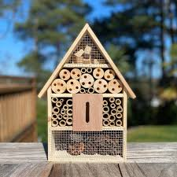
The Road to XSS
Websites let you input data all over the place
Comments
File uploads
URLs
Search bars
Etc
Every single one is a potential attack vector
Notes:
Finding the attack vectors is the beginning of finding exploit

Slide 5

The road continues…
Data is stored to be used and rendered to the user
So lets get exploiting that
Cross site scripting (XSS) is about getting the website to execute code where it displays this data.
Notes:
Rendered is key - any code is executed as the web server is trusted

Slide 6
XSS
XSS has three main types:
Reflected
Stored
Blind
DOM based
All of them use dynamic content loaded by the website to execute HTML, javascript, or any other code that the website will/can execute.

Slide 7
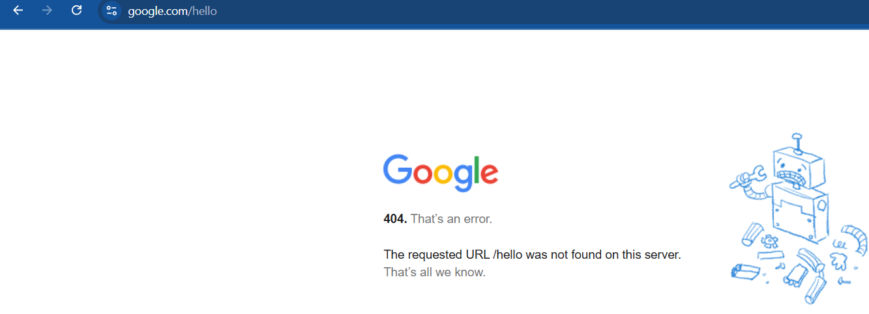
Reflected
This type is non-persistent
Often in search results or error messages
Its anywhere that the message to the server is reflected back to the user in the response. This is an example for educational, demonstrative purposes.

Slide 8
Stored XSS
Stored attacks store the malicious code on the database or server
The code is then executed at a later date
E.g.
Enter malicious code into a message on a message board
Everytime a user loads that message - the code is executed
Notes:
Huge danger as it executes everytime the data is rendered - if it is exploited on a popular site, then it can affect millions of people very easily

Slide 9
Blind XSS
Blind XSS is a subset of Stored XSS
It affects admin rather than normal users
E.g.
Enter malicious code into a feedback form
Code is then executed when an admin/staff member looks at the form results
Hard to know if its been completed - but potentially devastating for company internal systems

Slide 10
DOM Based XSS
A bit of a different story … which needs a little history lesson first
DOM (Document Object Model) is a representation of the webpage
Lets you change it with code - think document.write !
You actually use it all the time when you writing websites
https://developer.mozilla.org/en-US/docs/Web/API/Document_Object_Model/Introduction for more info!

Slide 11
DOM based XSS continued
DOM based attacks change the DOM on a clients page
The javascript that is running on the page is manipulated to execute malicious code
How does this differ from reflected or stored?
Its (often)not going through the HTTP Response!

Slide 12
Give me an example already!
http://www.some.site/page.html?default=<script>alert(document.cookie)</script>
This URL has a parameter called default
The javascript on the page accesses this parameter and uses the value in a document.write piece of code.
The javascript passes the parameter to the DOM
This executes the HTML and subsequent javascript
Then renders it to the page
This actually goes through the server as its in the HTTP response header
The bypass? URI fragments (the bits after a #)

Slide 13
Practical Time!
Go to: http://3.8.201.215
This is our site that is set up for you to hack into.
www.xss.shefesh.com This is our CTFd website - DO NOT HACK, but put your flags in.
Link not working? Try this: 13.41.197.60:8000
Enjoy!
There are 10 flags in total - not all of them are to do with XSS so explore!
Finished? Check out: https://tryhackme.com/room/axss

Slide 14
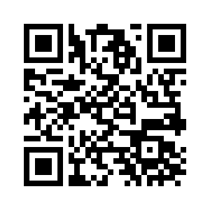
Feedback
Please leave your feedback :) We want to know what we can do to improve.
Please leave constructive and honest feedback only.
https://forms.gle/VTYd74K5BHqbC7F68

Slide 15
Upcoming Sessions
Guest Lecture - Prosanta Gope
Lecture Theatre 7
Monday 12th May
Please sign up if you are going!
What’s up next?
www.shefesh.com/sessions

Slide 16

Any Questions?
www.shefesh.com
Thanks for coming!

